Slide 1

Fellowship of the Heart
Getting Started — the Four Connects, walked around the table on alternating evenings
Evening Series 2026–27 · at the Tittle home · v1.5E DRAFT
All Scripture: ESV · The Companion lesson plans carry the full scripts — these slides carry the room
1
Notes:
DECK TITLE · pre-session · DIVIDER
On screen as the room assembles on night one. All Scripture ESV; the plans carry the scripts; these slides carry the room — and these notes carry you.

Slide 2
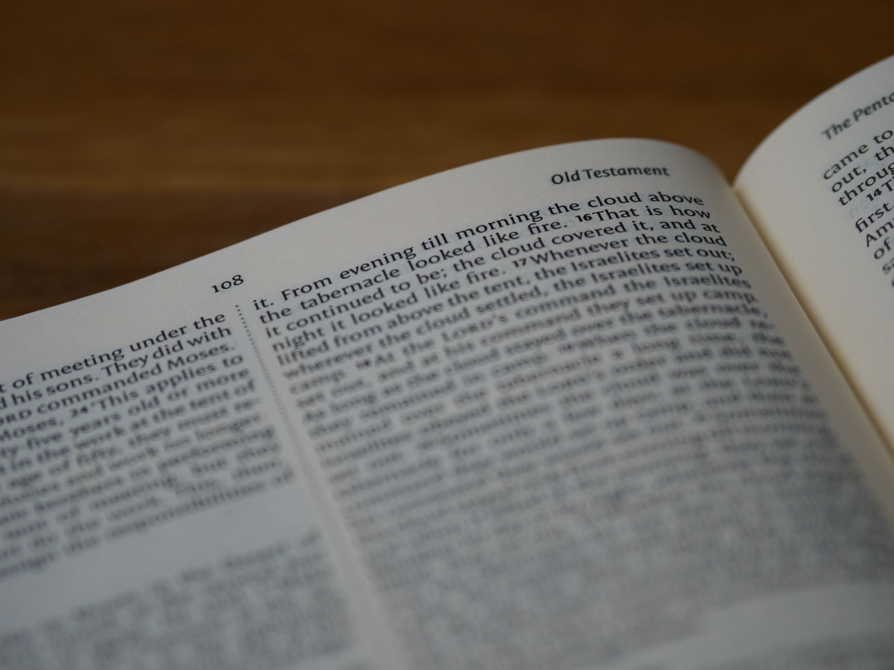
SESSION 8
Hearing God — PROAPT II
The second running — the practice received last week is led this week, by one of the room's own seniors
Quarter 2: Connect with God
116
Notes:
S8 · pre-session · DIVIDER
On screen through dinner and as the circle forms. Greet at the door — the slide holds the room.

Slide 3




Where We Are — the Four Connects
Session 8 stands in the third box — Connect with God — walked again, teen-led. Each connection makes the next one real (Matt. 22:37–40).
117
Notes:
S8 · WELCOME · LEAD: CONTAINER HOLDER · GROUNDING — every session opens on this map
BEATS:
1. Locate tonight on the map, plainly: Session 8 stands in the third box — Connect with God — walked again, teen-led. Each connection makes the next one real (Matt. 22:37–40).
2. The four boxes are one journey — each connection makes the next one real — rooted in the two great commandments: love God, love neighbor (Matt 22:37–40).
3. This is also the 'where we are on the map' minute the welcome owes any newcomer.
CUES: Two minutes at most; then tonight's road.

Slide 4

Session 8 — Tonight’s Road
1 Welcome and centering
2 Daily-practice check-in
3 Why a second running
4 PROAPT walked together — Mark 2:1–12
5 Bridge to the pairs and pair structure
6 PROAPT in family pairs in pairs
7 Tell step — sharing in the pair
8 Merge and homework
9 The Leader Feedback Round — both leaders
10 Closing container
118
Notes:
S8 · 7:00–7:08 · LEAD: CONTAINER HOLDER
BEATS: 1. Today is teen-led end to end: a Companion-in-Formation leads the welcome, the Mark 2:1–12 walk-through, the bridge, and the closing blessing. 2. Nothing new is taught — the second running completes what Week 7 began, and one senior gets their marquee. 3. Adults' discipline: chairs slightly outside the circle, eyes on the senior, no rescuing.
CUES: If the room's eyes drift to the adults, look at the senior — the room learns who leads from where the adults look.

Slide 5
Opening Container — the Eight Steps
1 Welcome — five minutes to open the container
2 Phones silenced and put away
3 Stand in a circle
4 One-word check-in — how you actually are, right now
5 Put out / bring in — set something down; bring a blessing in
6 Spoken commitment: “I am here. I am paying attention. I am willing to be moved.”
7 Opening prayer — “Holy Spirit, you are welcome here. Speak. We are listening.”
8 Sit. Begin.
119
Notes:
S8 · 7:00–7:08 · LEAD: CONTAINER HOLDER
BEATS: 1. The senior speaks the Aaronic blessing and restates the container: Safe, Present, Clear, Intentional. 2. Their frame: seven weeks ago most of us walked in not knowing what this was; today one of us is leading it — that is the design. 3. 'The team is here. But the practice is ours now.'
CUES: Adults sit back from the senior's first word. A ten-second stumble the senior recovers from is worth more than a smooth block an adult saved.
PAIR LEAD: name the leading pair in the welcome — two leaders hold tonight, and the room will see the evening handed back and forth between them; that is the design. The pair practices the session together beforehand.

Slide 6

Daily-Practice Check-In
• “One sentence each, whoever wants: how did the week of daily practice actually go? Honest answers.”
– “‘I did two days and stopped’ is an honest answer.”
• A parent starts the round — arranged beforehand; anyone may pass
• Thin or empty week? No guilt — “The practice picks up where you are, not where you were supposed to be.”
• “Tonight is a fresh start” — everything tonight works whether you did seven days or zero
120
Notes:
S8 · 7:08–7:25 · LEAD: CONTAINER HOLDER
BEATS: 1. Senior asks: one sentence each — how did the week of daily PROAPT actually go? 'I did two days and stopped' is an honest answer. 2. Take 2–3 contributions; receive them all the same way. 3. Normalize the restart: this stretch is where daily practice thins for almost everyone — the practice picks up where you are, not where you were supposed to be. No guilt.
CUES: Arranged parent opens (check the Run Card) — never cold-call a teen; pass-anytime holds.

Slide 7
Why a Second Running
• Word → Hearing → Faith — “hearing is a skill, and skills take reps. Last week was rep one. Tonight is rep two.”
• Tonight one of the room’s own leads the walk-through — “The team is here. But the practice is ours now.”
• Tonight’s passage: Mark 2:1–12 — the paralytic whose friends dig through a roof to get him to Jesus
• Already PROAPTed it this week? Good — “a passage speaks differently on a second hearing. That’s not a theory; you’re about to test it.”
• Same six steps as last week — Bibles open to Mark 2
ROMANS 10:17
“So faith comes from hearing, and hearing through the word of Christ.”
121
Notes:
S8 · 7:25–7:28 · LEAD: CONTENT PRESENTER
BEATS: 1. Romans 10:17 restated: Word, hearing, faith — hearing is a skill and skills take reps; last week was rep one, today is rep two. 2. Frame Mark 2:1–12 — the paralytic whose friends dig through the roof. 3. Some have already PROAPTed it in daily practice: don't skip it — a passage speaks differently on a second hearing, and today tests that. 4. Handouts around; Bibles open to Mark 2.

Slide 8

PROAPT Walked Together — Mark 2:1–12
1 Pray — “Tell the Holy Spirit you want to hear what He has for you tonight — not what you already know about this passage.”
2 Read — once aloud, slowly; then silence while the room reads to receive
3 Observe — two layers, in order: first the data, straight off the page, then the interpretation — what stands out or surprises you in it. “Write three things — data first.”
4 Apply — “Where in your life are you the one on the mat — stuck, carried, waiting? Or are you one of the four — and who are you carrying?”
5 Pray again — “Tell God what you heard. Tell Him what you’re willing to do — or what you’re struggling to be willing to do.”
6 Tell — in your family pair tonight — “it’s the step that makes the hearing stick.”
122
Notes:
S8 · 7:28–7:42 · LEAD: CONTENT PRESENTER
BEATS: 1. The marquee: the senior leads all six steps, timed, from facilitation card H8.1; the room works handout H8.2. 2. PRAY 90s, READ 2 min, OBSERVE 3.5 min (data then surprise; 3–4 shares), APPLY 3.5 min ('YOU, today, specifically'; 2–3 shares), PRAY AGAIN 90s, TELL 60s (in the pairs). 3. Adults: do not speak, do not rescue a silence, let a stumble recover itself — the recovery is the formation.
CUES: The handoff rule is live: anything heavy — the senior catches the adult's eye, hands it over, keeps holding the room. The senior never takes a disclosure.

Slide 9
Bridge to the pairs — Pair Structure
• Same pair structure as last week — parent with teen, from your own family, by default
• One Reader, one Listener — after thirteen minutes, switch; stay with Mark 2 or take a fresh passage
• “Same pair as last week is not a rerun — a parent and a teen telling each other what they heard, a second week running, is the design working.”
• Your Lead Companion settles any odd numbers; a small room stays as one circle
• “Father, You’ve already spoken tonight. Speak again in the pairs — something specific, something each of us can hear.”
123
Notes:
S8 · 7:42–7:43 · LEAD: CONTENT PRESENTER · TRANSITION
BEATS: 1. Senior restates the pair shape: parent with own teen by default; Reader and Listener; switch at thirteen minutes; same passage or fresh — Reader's choice. 2. Same pair as last week is not a rerun — a parent and a teen telling each other what they heard, a second week running, is the design working. 3. Pray and send.
CUES: Lead Companions settle odd numbers. Room about ten or fewer: stay as one circle, pair in place.

Slide 10
PROAPT in Family Pairs
1 First pass (13 min) — Reader leads PROAPT; Listener works alongside without interrupting
2 Reader’s Tell at the end goes to the Listener — one sentence
3 Switch — roles reverse; same passage or new
4 Second pass (13 min) — same structure, roles reversed
• Same unstick prompts as Week 7 — “one specific word or phrase that caught you” / “one situation in your life right now — be specific”
• Feels like a rerun? “Then you know what it said Thursday. What is it saying tonight? Second hearings are where the specific word comes.”
124
Notes:
S8 · 7:43–8:11 · LEAD: CONTENT PRESENTER · PAIRS
BEATS: 1. First pass 13 min, switch, second pass 13 min — Reader leads, Listener works alongside without interrupting. 2. Same unstick prompts as Week 7: Observe — 'one word that caught you'; Apply — 'one situation, be specific'; slow the rushers; early finishers take another passage. 3. New this week — the pair treating it as a rerun: 'You know what it said Thursday. What is it saying today? Second hearings are where the specific word comes.'
CUES: Heavy material goes to the adults, always — receive the handoff so it costs the senior nothing.

Slide 11
Tell Step — Sharing in the pair
• “The Tell step — second time in the pair, so you know the shape.”
• One specific thing you heard tonight — one sentence — “We listen to receive.”
• A parent opens the round — arranged beforehand, never a cold call on a teen
• Teens choose their own depth; pass-anytime holds
• Receive without preaching — “We hear that.” “Thank you for naming that.”
• “Take what you heard with you. It was given to be walked out.”
125
Notes:
S8 · 8:11–8:17 · LEAD: CONTENT PRESENTER · PAIRS
BEATS: 1. Back into pairs. One specific thing you heard today, one sentence — second time in the pair, the room knows the shape; let the expectation work. 2. Receive each: 'We hear that.' Brief. No preaching. 3. Close: take what you heard with you — it was given to be walked out.
CUES: Arranged parent opens (check the Run Card) — never cold-call a teen; teens choose their own depth; pass-anytime holds.

Slide 12

Merge and Homework Practice
• Daily PROAPT continues — one passage, five to fifteen minutes, every day (journal Week 7–8 pages)
• “If last week thinned out, restart tomorrow. No guilt, no doubling up.”
• “Take a moment on the way home to notice what just happened in this room. One of our own led the whole practice tonight. That is the design working.”
126
Notes:
S8 · 8:17–8:20 · LEAD: CONTAINER HOLDER
BEATS: 1. The adult Lead Companion takes this block. 2. Daily PROAPT continues — one passage, five to fifteen minutes, every day; journal Week 7–8 pages. If last week thinned, restart tomorrow — no guilt, no doubling up. 3. Name what just happened: one of our own led the whole practice today; that is the design working. Suggest the car-ride version privately to parents — what they saw in the senior who led.

Slide 13
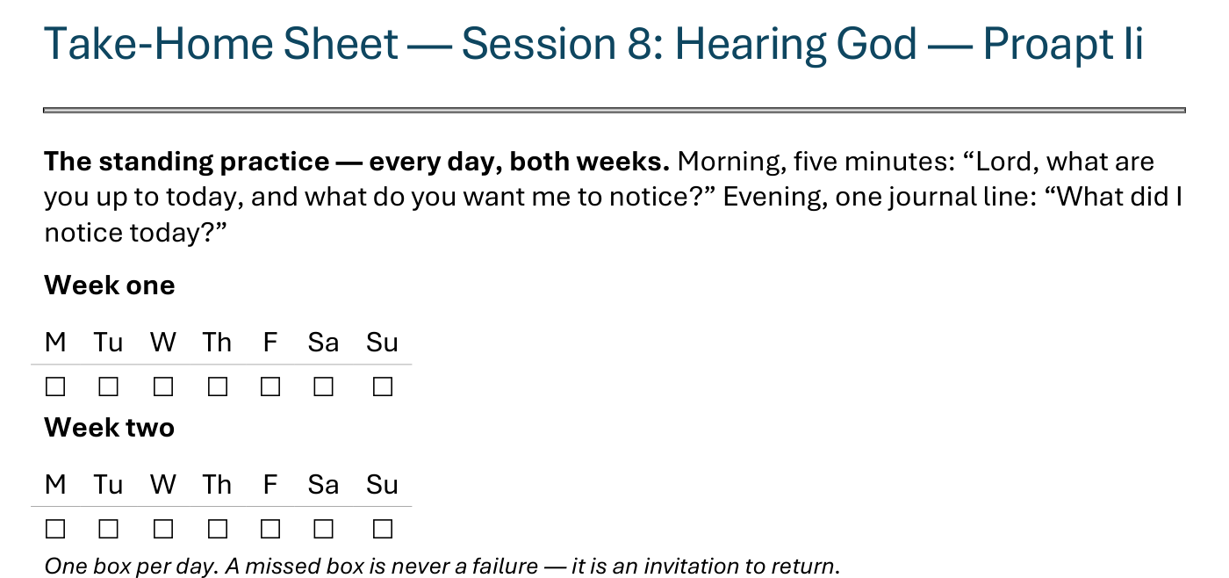
The Take-Home Sheet — the Daily Rhythm
Handed out now — this is the sheet in your hands.
127
Notes:
S8 · COMMISSIONING · LEAD: CONTENT PRESENTER
BEATS:
1. The sheet on the screen is the sheet in their hands — walk it, don't read it.
2. The standing rhythm first: the morning question, the evening journal line — one box per day on the week-grids.
3. A missed box is never a failure — it is an invitation to return.
CUES: The four parts are the next slide.

Slide 14
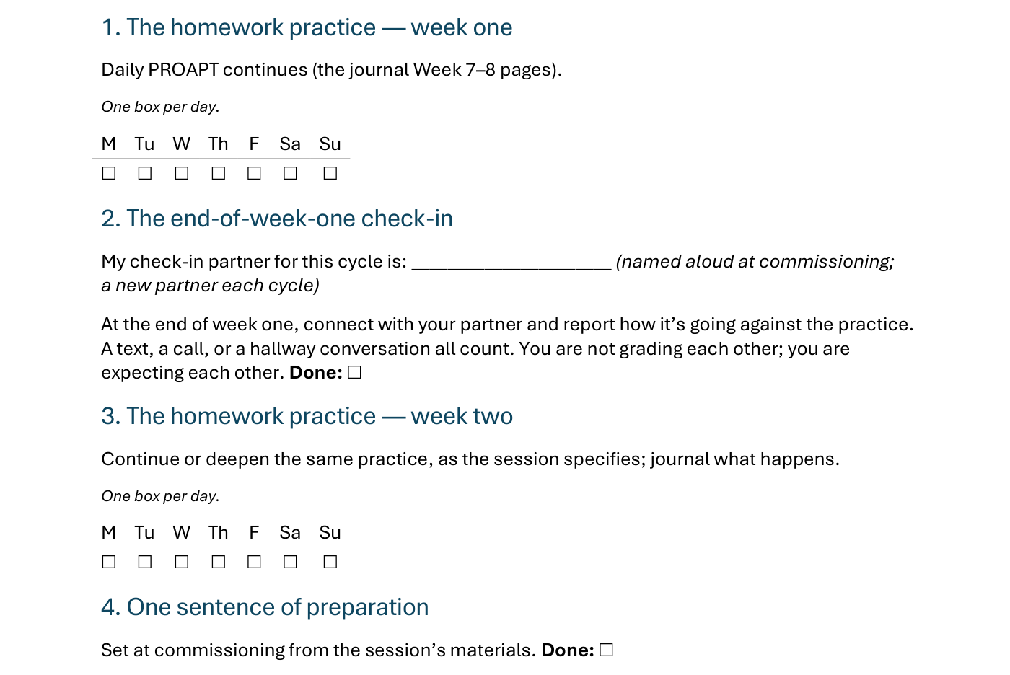
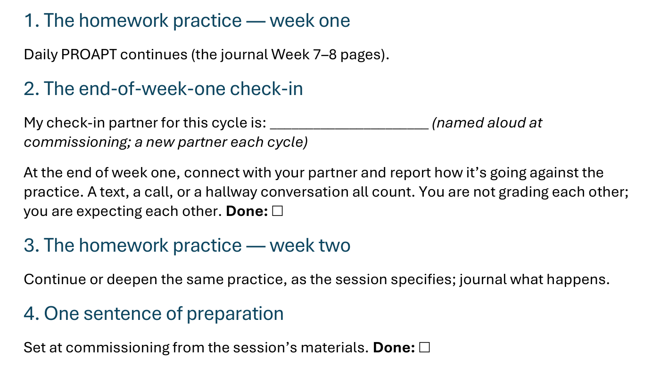
The Take-Home Sheet — the Four Parts
One practice at a time — and a partner expecting you at the end of week one.
128
Notes:
S8 · COMMISSIONING · LEAD: CONTENT PRESENTER
BEATS:
1. The four parts, in order: the homework practice, week one; the end-of-week-one check-in; the homework practice, week two; one sentence of preparation.
2. Check-in partners are named aloud before leaving this slide — the sheet has the line to write the name.
GUARD: The sheet-walk, not a re-teach.

Slide 15

The Leader Feedback Round
• Two rounds, same as every session — the container holder first, then the content presenter: three things each
– “What I think went well tonight: ______”
– “What I’d do differently next time: ______”
– “If I were to teach tonight’s process to someone, I would tell them: ______”
• Then the room — the same two questions about tonight
• The leaders receive without defending — “thank you” is the whole response
129
Notes:
S8 · 8:24–8:28 · LEAD: BOTH LEADERS
BEATS: 1. Merged order today — a teen led: the senior answers the round's questions FIRST, the adult second. 2. The adult adds one specific affirmation of the senior ('you held the silence after Apply and didn't fill it') and at most ONE growth item — one thing, not a list. 3. Then, only by the senior's consent, the room takes the same two questions — popcorn, 'for you' language, covering both leaders. 4. Receive without defending; if the senior declines the room's round, it ends after the adult — no pressure, no exposure.

Slide 16
Closing the Container + Aaronic Blessing
• We close the way we opened — the container, six steps:
1 Stand again — same circle, same posture as the open
2 One-word landing — compare it to your opening word
3 The one thing you are taking from tonight
4 The one practice — committed aloud, or modified to one you will actually keep
5 Blessings — specific, witnessed, short
6 Closing prayer — and the Aaronic blessing, spoken over each other, face to face
THE AARONIC BLESSING — NUMBERS 6:24–26
“The Lord bless you and keep you;
the Lord make his face to shine upon you, and be gracious to you;
the Lord lift up his countenance upon you, and give you peace.”
130
Notes:
S8 · 8:28–8:30 · LEAD: CONTAINER HOLDER
BEATS: 1. The senior closes: seven weeks ago none of us had done this; when we gather we go deeper, into the Garden — today's skill of hearing Him is what the Garden depends on. 2. 'Keep the daily practice alive this week. It's the hinge.' 3. Aaronic blessing, spoken by the senior — its own quiet milestone. 4. 'PROAPT one passage tomorrow. See you evenings.'

